Slide 1
IS 4430: Systems Analysis and Design
Jon Soldan Operations and Information Systems

Slide 2
The Requirements Process

Slide 3
What are Requirements?
“A requirement is something a the product must do to support its owner’s business, or a quality it must have to make it acceptable and attractive to the owner.”
Mastering the Requirements Process – Johnson and Johnson

Slide 4
The Requirements Process
No one way or silver bullet to manage requirements
“If the right product is to be built, then the right requirements have to be discovered.”
Volere (sample approach) - Not intended to be Waterfall or Iterative, overarching process regardless of development approach

Slide 5
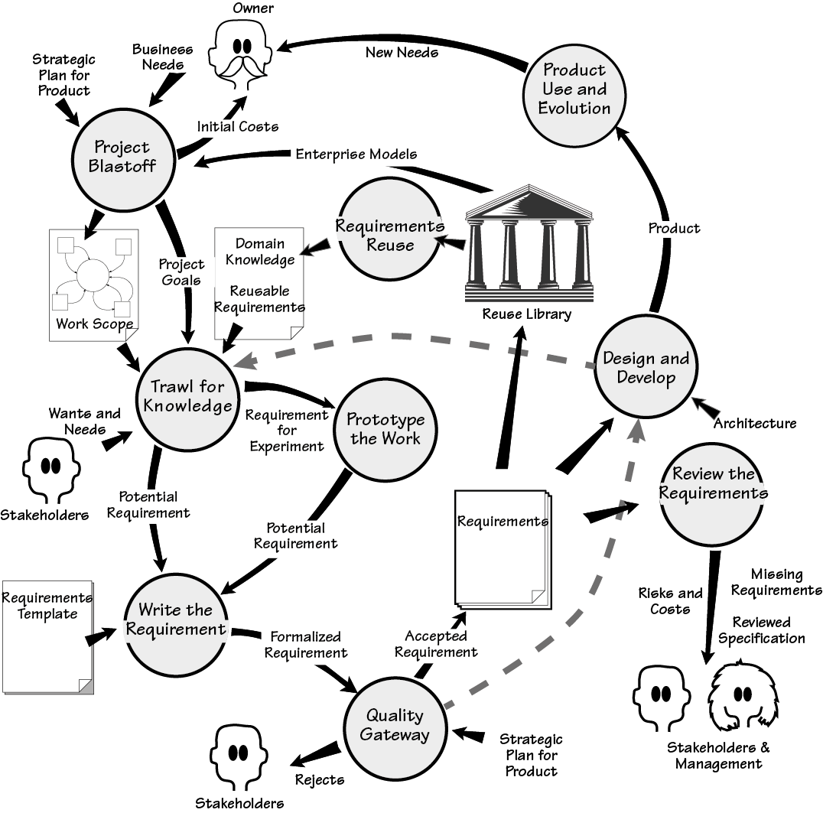
This map of the Volere Requirements Process shows the activities and their deliverables. Each activity (the bubbles) and its deliverables (named arrows or documents) are explained in the text. The dotted lines represent how this process is used with iterative projects.

Slide 6
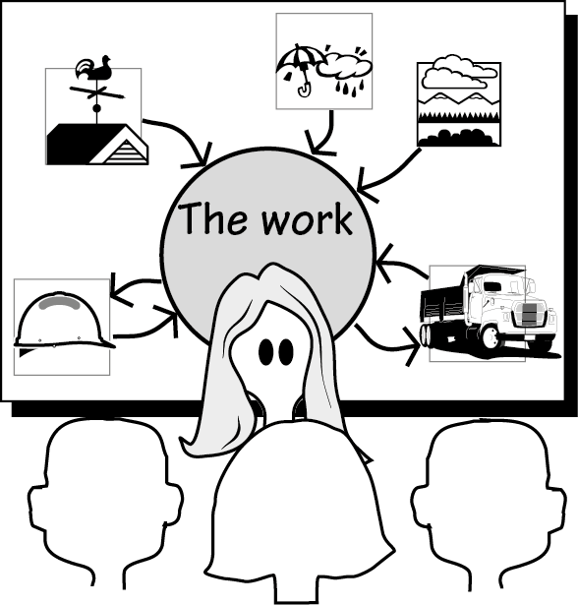
Figure 2.2
The context diagram is used to build a consensus among the stakeholders as to the scope of the work that needs to be improved. The eventual product will be used to do part of this work.

Slide 7
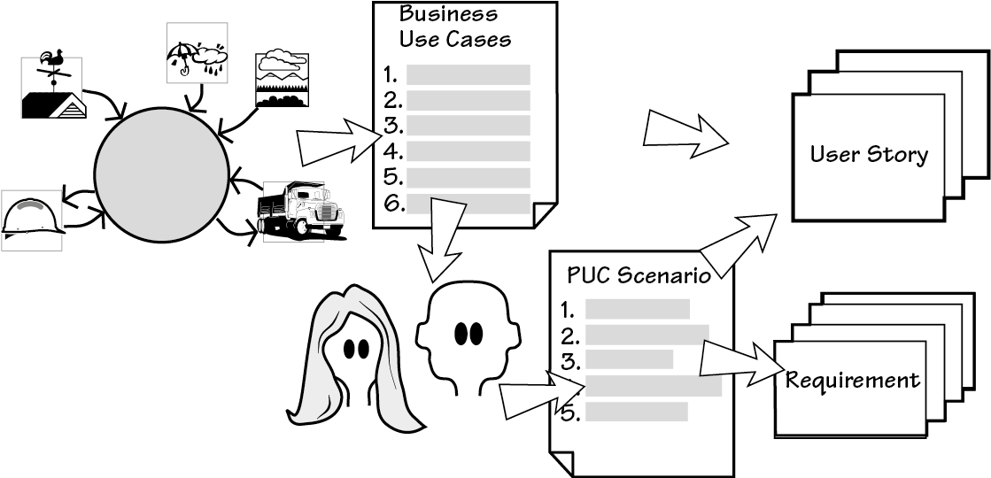
Figure 2.3
The blastoff determines the scope of the work to be improved. The business use cases are derived from the scope. Each of the business use cases is studied by the requirements analysts and the relevant stakeholders to discover the desired way of working. When this is understood, the appropriate product can be determined (the PUC scenario) and requirements or user stories written from it.

Slide 8
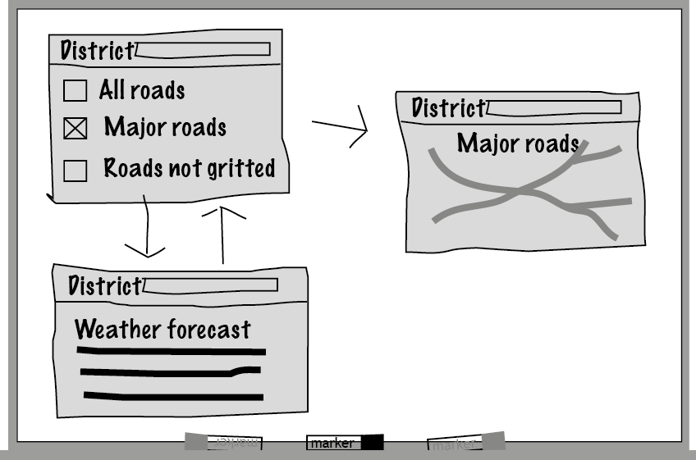
Figure 2.4
A quick and dirty prototype built on a whiteboard to provide a rapid visual explanation of how some of the requirements might be implemented, and to clarify misunderstood or missing requirements.

Slide 9

Mock-Up Tool: Balsamiq

Slide 10
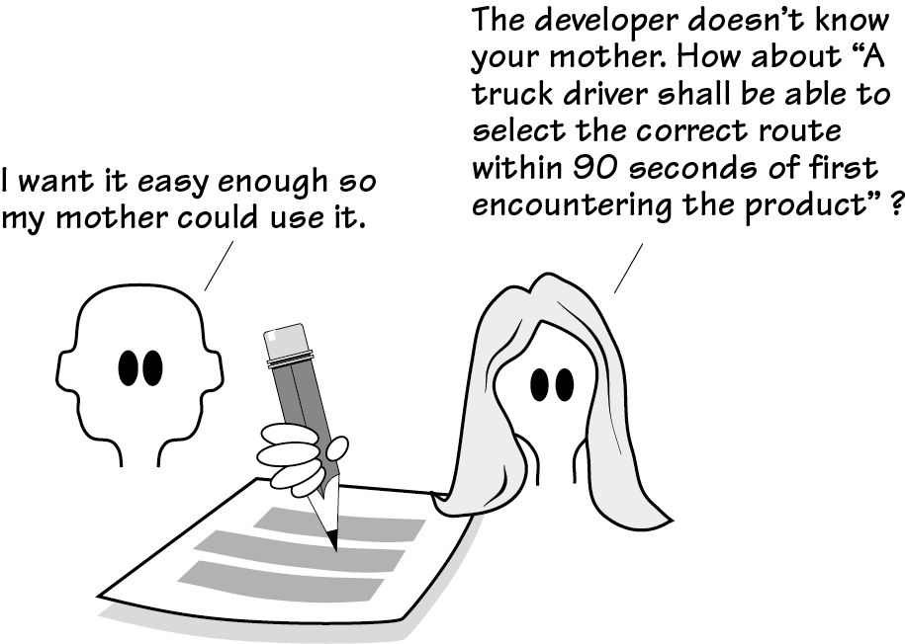
Figure 2.5
The requirements are captured in written form to facilitate communication between the stakeholders, the analysts, and the developers (and anyone else who has an interest). By writing the requirements carefully, the team ensures that the correct product is built.

Slide 11
Requirements Documentation
Software Requirement Specification (SRS)
Requirements Specification Template
Use Cases
User Stories
Snow Cards
Etc.

Slide 12
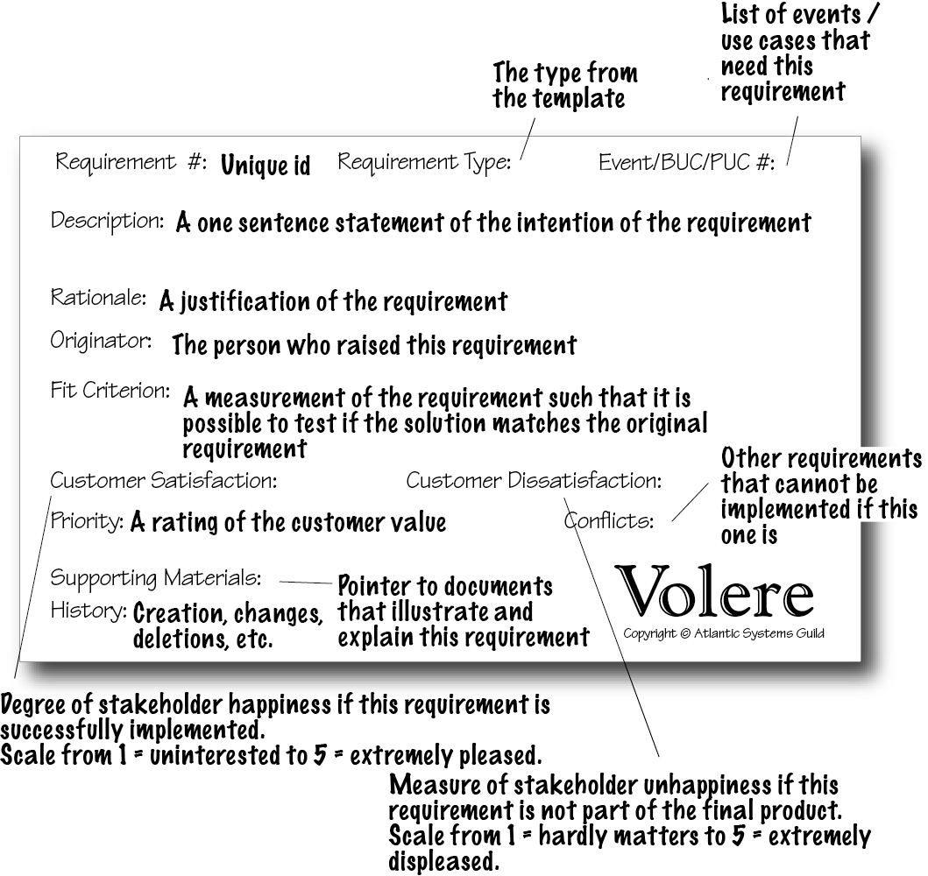
Figure 2.9
The requirements shell or snow card, consisting of a 5-inch by 8-inch card, printed with the requirement’s attributes, that is used for our initial requirements gathering. Each of the attributes contributes to the understanding and testability of the requirement. Although a copyright notice appears on the card, we have no objections to any reader making use of it for his or her requirements work, provided the source is acknowledged.

Slide 13
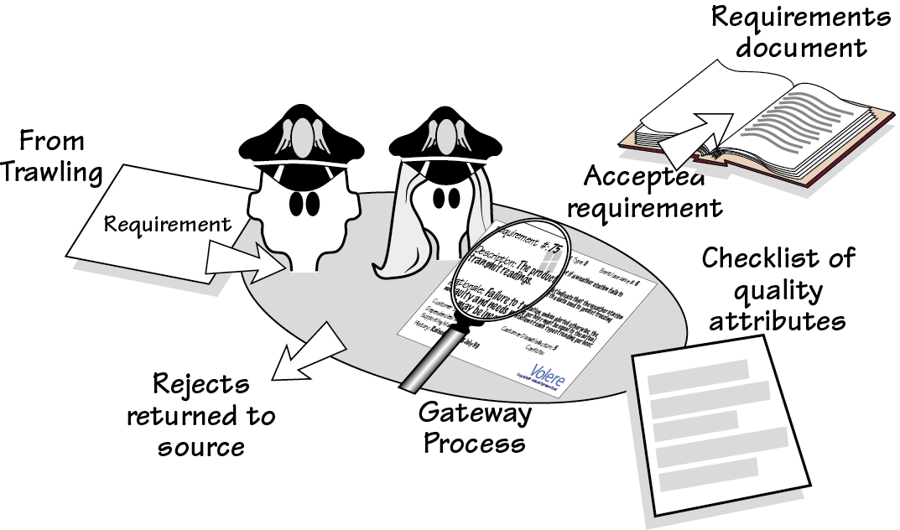
Figure 2.6
The quality gateway ensures that require­ments are rigorous by testing each one for completeness, correctness, measura­bility, absence of ambiguity, and several other attributes, before allowing the requirement to be passed to the developers.

Slide 14
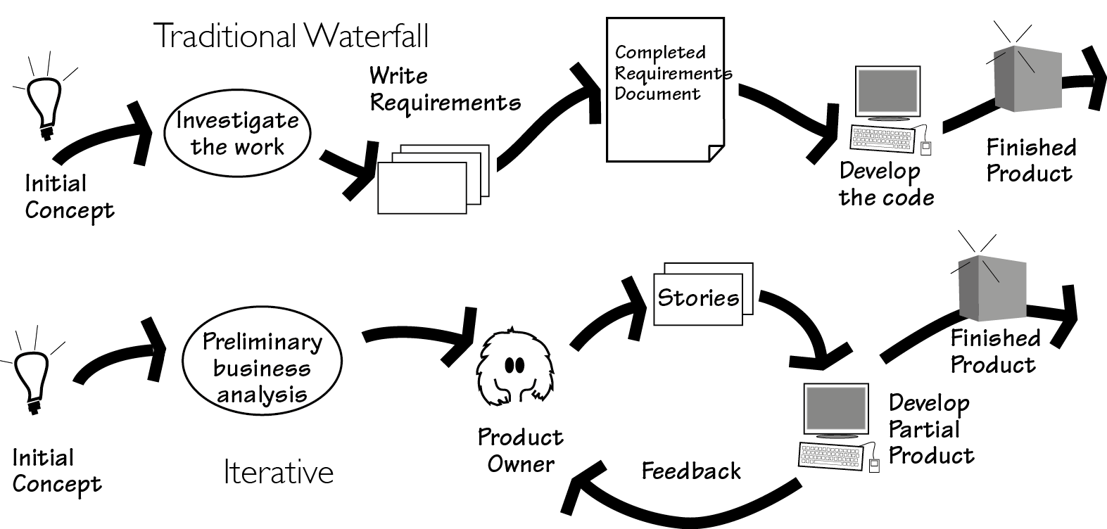
Figure 2.7
Two (of many) variations on development life cycles. At the top of the figure is the traditional waterfall approach, in which the complete requirements document is put together before product development begins. At the bottom of the figure is an iterative process, in which, after a preliminary analysis, the product is developed in small increments. Both approaches achieve the same purpose.

Slide 15
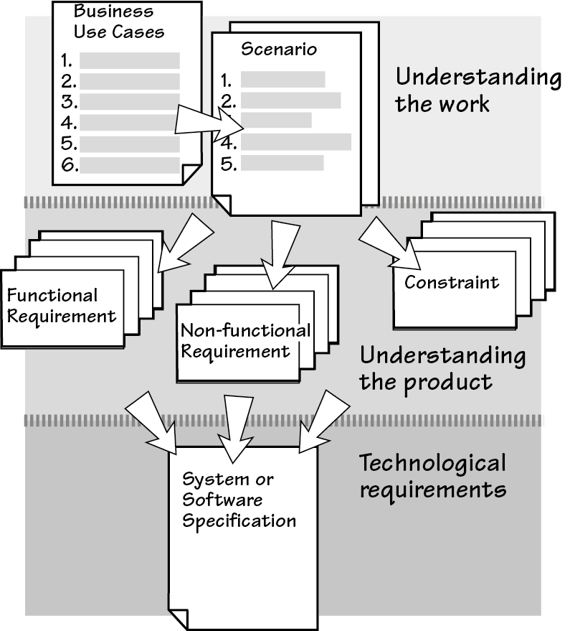
The Evolution of Requirements

Slide 16
Volere Template Review (Posted on Canvas)

Slide 17
KNOW YOUR ENVIRONMENT!!!
No one way to manage requirements and build the information system
Know your stakeholders and work accordingly
Be strategic in process improvement
Be flexible and adapt
Who is your audience?
Marginal analysis – assess the ROI

Slide 18
Creating Data Flow Diagrams (DFDs) – Context Level and Level 0

Slide 19
Data Flow Diagrams
Graphically characterize data processes and flows in a business system.
Depict:
System inputs
Processes
Outputs
Systems Analysis and Design – Kendall and Kendall

Slide 20
Advantages of the Data Flow Approach
Freedom from committing to the technical implementation too early
Understanding of the interrelatedness of systems and subsystems
Communicating current system knowledge to users
Analysis of the proposed system
Systems Analysis and Design – Kendall and Kendall

Slide 21
Basic Symbols
A double square for an external entity
An arrow for movement of data from one point to another
A rectangle with rounded corners for the occurrence of a transforming process
An open-ended rectangle for a data store
Systems Analysis and Design – Kendall and Kendall

Slide 22
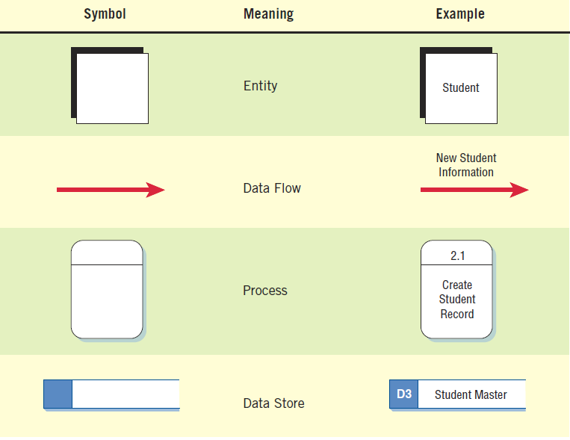
The Four Basic Symbols Used in Data Flow Diagrams
Systems Analysis and Design – Kendall and Kendall

Slide 23
External Entities
Represent another department, a business, a person, or a machine
A source or destination of data, outside the boundaries of the system
Should be named with a noun
Systems Analysis and Design – Kendall and Kendall

Slide 24
Data Flow
Shows movement of data from one point to another
Described with a noun
Arrowhead indicates the flow direction
Represents data about a person, place, or thing
Systems Analysis and Design – Kendall and Kendall

Slide 25
Process
Denotes a change in or transformation of data
Represents work being performed in the system
Naming convention:
Assign the name of the whole system when naming a high-level process.
To name a major subsystem attach the word subsystem to the name.
Use the form verb-adjective-noun for detailed processes.
Systems Analysis and Design – Kendall and Kendall

Slide 26
Data Store
A depository for data that allows examination, addition, and retrieval of data
Named with a noun, describing the data
Data stores are usually given a unique reference number, such as D1, D2, D3
Represents a:
Database
Computerized file
Filing cabinet
Systems Analysis and Design – Kendall and Kendall

Slide 27
Creating the Context Diagram
The highest level in a data flow diagram
Contains only one process, representing the entire system
The process is given the number 0
All external entities, as well as major data flows are shown
Systems Analysis and Design – Kendall and Kendall

Slide 28
Basic Rules
The data flow diagram must have one process.
Must not be any freestanding objects
A process must have both an input and output data flow.
A data store must be connected to at least one process.
External entities should not be connected to one another.
Systems Analysis and Design – Kendall and Kendall

Slide 29
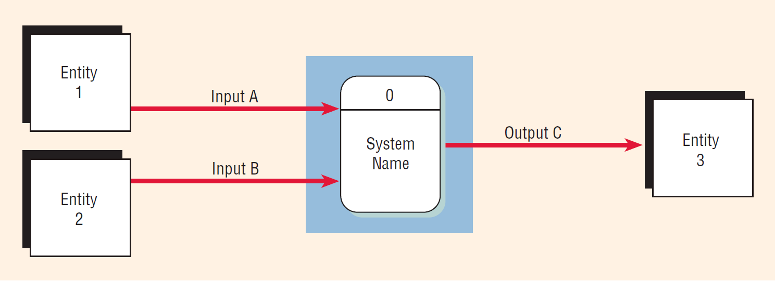
Context Diagram
Systems Analysis and Design – Kendall and Kendall

Slide 30
Drawing Diagram 0
The explosion of the context diagram.
May include up to nine processes.
Each process is numbered.
Major data stores and all external entities are included.
Systems Analysis and Design – Kendall and Kendall

Slide 31
Drawing Diagram 0 (Continued)
Start with the data flow from an entity on the input side.
Work backwards from an output data flow.
Examine the data flow to or from a data store.
Analyze a well-defined process.
Take note of any fuzzy areas.
Systems Analysis and Design – Kendall and Kendall

Slide 32
Note Greater Detail in Diagram
Systems Analysis and Design – Kendall and Kendall

Slide 33
Thank You
Questions?

